Slide 1
Wibmo (A PayU Company)

Slide 2
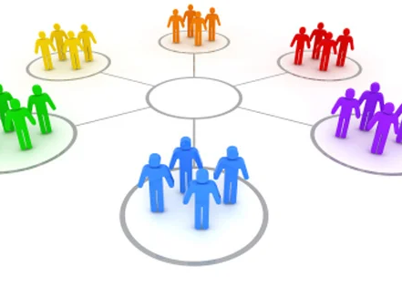
Stakeholders
Sponsors
Wibmo – A PayU Company
SME’s
Amit Balyan
HR and others
Anvita Rai

Slide 3

Our Vision
A highly scalable and efficient Course Registration System, integrated with various powerful tools like SpringBoot REST, JPA, JWT, Apache Kafka and Redis in the backend which can be seamlessly migrated to frontend ui-ux frameworks and the microservices involved can also be extended to other backend frameworks.

Slide 4
5 Weeks of Training + Project Demo
25 Days
200 Hours
12,000 Minutes
7,20,000 Seconds
LIMITLESS KNOWLEDGE

Slide 5
Agenda
Our Journey
Our Team
Team Structure
Project Goals
Engineering Practices
Tech Stack
Development
Challenges and Learnings
Demo
Questions

Slide 6

Our Journey

Slide 7
Understanding Project Requirements and Creating UML Diagrams
Further optimization and performance improvement through JWT, Kafka and Redis
Migration to Individual Microservices hosted on Eureka Server which is load balanced by API Gateway
Developing POS Application and Database Integration with JDBC
Integration with REST Services and JPA Repository Interface

Slide 8

Our Team

Slide 9


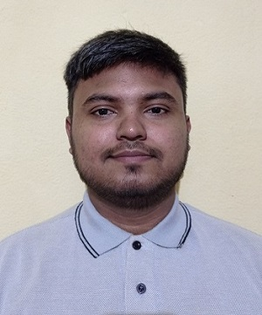

Veda Sree
(Microservices Design Expert)
Parth Patel
(Git and Message-queue Specialist)
Abhay Prakash
(QA – Testing)
Raj Kumar Raj
(Developer in REST Services)

Slide 10
Team Structure
Our Team consisted of 4 members.
All the team members contributed equally and took ownership of the project equally.
We supported each other throughout the journey, whether there was a bug encountered while working on the project or whenever there was a dilemma on how to implement a specific feature and its methodology.
We learnt how to write things like unit tests together and helped each other whenever we faced any blockers.

Slide 11

Project Goals
To provide a centralized platform for managing all aspects of the Course Registration process.
To manage the entire process from Student Registration, to Admin functionalities like Approval, handling of courses till Professor functionalities like abilities to add grades and view students enrolled for the course; a comprehensive system has been developed.
To provide a way for students to get notified when their actions are successful and also to make payments for the registered courses.
To provide a way for admin to modify the course catalog, generate report cards for students and also manage users.
To provide a way for professors to view the students enrolled in only those courses which he teaches.

Slide 12

Engineering Practices

Slide 13
Implemented SOLID principles
Singleton Instance
Asynchronous communication between microservices
Containerized approach
Postman for API testing
GitHub for Source code management and version control
Seamless UI/UX integration

Slide 14

Tech Stack

Slide 15










Backend
Data
SCM
Git
MySQL

Slide 16

Development

Slide 17
UML Artifacts
Use-case diagram
POS
Desktop Application
REST
Web Application
Micro Services
Eureka Server
Kafka message queue implementation
Redis cache implementation
JPA
JDBC Integration
Class diagram
Activity diagram
API Gateway

Slide 18

Challenges and Learnings

Slide 19
Challenges
Complex Business Logic
Concurrency
Scalability
User Experience
Data Security
Testing
Learnings
Software Architecture
Database Design
User-Centered Design
Version Control
Communication
Time Management

Slide 20

Demo

Slide 21

Questions

Slide 22


